Slide 1
Improving the SBOL Visual Glyph Collection
Bryan Bartley, Jacob Beal, Robert Sidney Cox, Thomas Gorochowski, Augustin Luna, James McLaughlin, Chris Myers, Tramy Nguyen, Ernst Oberortner, Nicholas Roehner, Herbert Sauro and Anil Wipat
COMBINE, October 2017

Slide 2
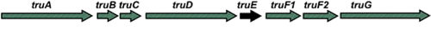
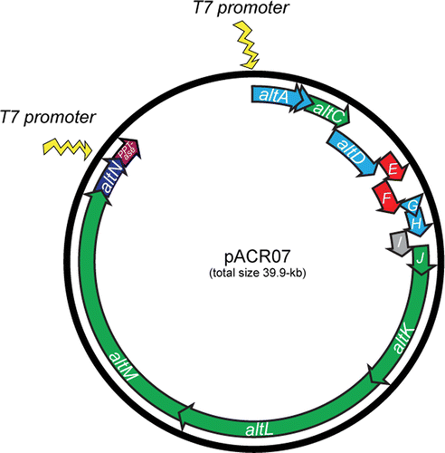
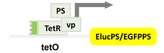
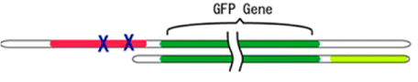
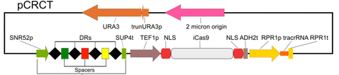
Problem: Communicating Genetic Constructs
Construct diagrams from some recent ACS Syn.Bio. papers:
Well, they're sort of similar…
Notes:
I'm not picking on anybody - I just took the most recent 5 "just publishable" papers with constructs

Slide 3
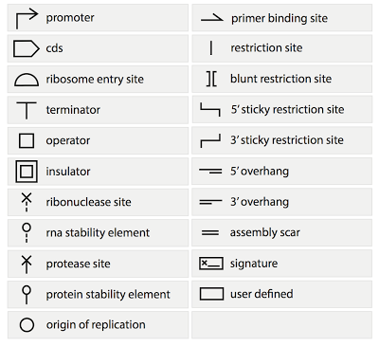
SBOL Visual 1.0:

Slide 4
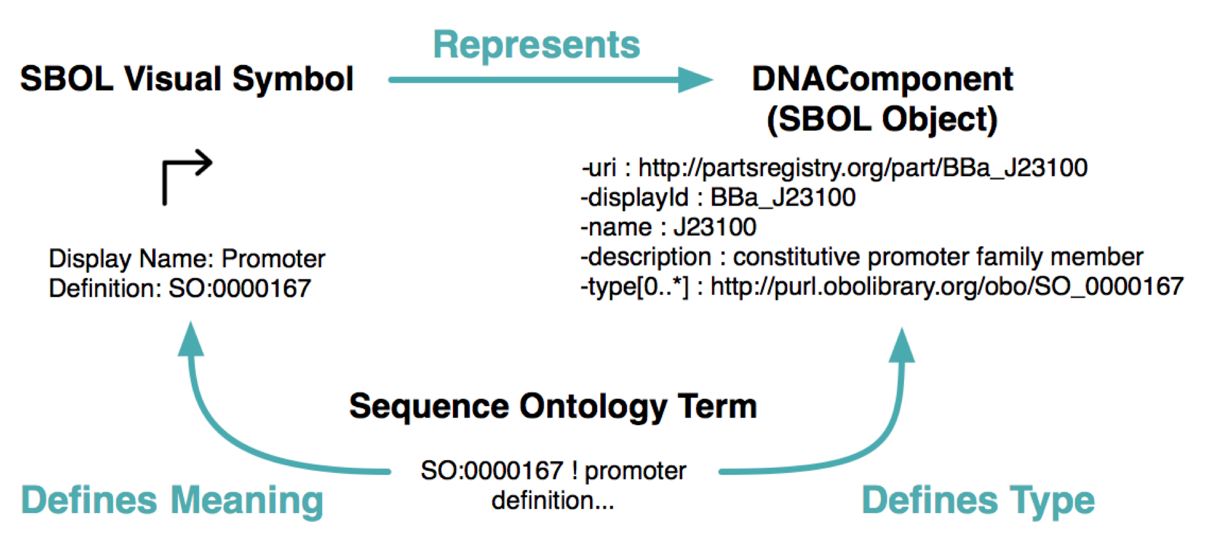
Backing by Formal Semantics

Slide 5

Elements of SBOL Visual (1.0 → 2.0):
Nucleic Acid Component Glyphs
Other Component Glyphs
GFP
Interactions
gfp
pTet
tetR
Display IDs
Reverse Complement Nucleic
Acid Component Glyphs
Nucleic Acid Backbone
Synthetic Biology Open Language - Visual
Community standards in development since 2008
SBOL Visual 1.0: BBF RFC #93 doi: 1721.1/78249
SBOL Visual 2.0: https://github.com/SynBioDex/SBOL-visual

Slide 6
Progress to SBOL Visual 1.1 / 2.0
Bounds, interior, alignment, scale SEP V001
Alternative glyphs SEP V002
Distinguishing unknowns SEP V003, V006
Ambiguities, variants for current glyphs SEP V005
New nucleic acid region glyphs SEP V004, V007
Chemical species glyphs SEP V008
Interactions [tbd]
Modules, Ports, Mappings [tbd]

Slide 7
Bounds, interior, alignment, scale
Bounding box for edge
Designate interior region
Alignment to NA backbone
Prototype gives RECOMMENDED scale

Slide 8





Distinguished unknowns
“User Specified”
Unspecified
No Glyph Assigned
Composite

Slide 9
Ambiguities, variants for current glyphs
Clarify backbone location:
Replace operator glyph:
Clarify insulator interior:
Alternative CDS:

Slide 10
New nucleic acid region glyphs
Aptamer
Specific Recombination Site
ORI-T
Non-Coding RNA Gene
polyA

Slide 11
Hot off the press
This week (SEP V004):
Aptamer glyph accepted
ORI-T glyph accepted
polyA Site glyph accepted
Specific Recombination Site glyph accepted
Debate continues on non-coding RNA gene
Non-Coding RNA Gene

Slide 12


Hot off the press
This week (SEP V005):
Scar Glyph alignment accepted
Coding sequence glyph & alternative
alignment to middle
Restriction site alignment accepted
Overhang and sticky restriction site alignment accepted
Interior of the insulator glyph being defined as the inner & alignment accepted
New operator glyph accepted
Origin alignment accepted
User defined alignment accepted

Slide 13
Next steps
Consensus on rest of new glyphs
Interactions, modules compatible with SBGN
Finish formalization into specification
SBOL Visual 1.1 → late 2017
SBOL Visual 2.0 → mid-2018
Trying for faster, but community can’t be rushed

